Slide 1

Multi Layer Perceptron
NASTARAN SHAHPARIAN |SHARCNET | COMPUTE ONTARIO | COMPUTE CANADA |YORK UNIVERSITY

Slide 2
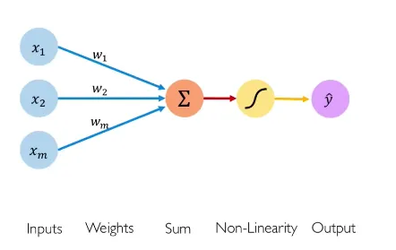
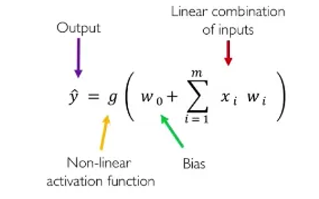
Simple Perceptron
https://medium.com/analytics-vidhya/neural-network-part1-inside-a-single-neuron-fee5e44f1e

Slide 3
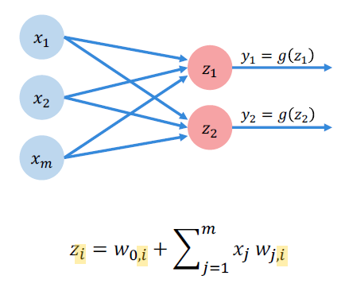
Multi Output Perceptron
Since all inputs are densely connected to outputs, this layer is called "dense" layer
© Alexander Amini and Ava Amini MIT Introduction to Deep Learning IntroToDeepLearning.com

Slide 4

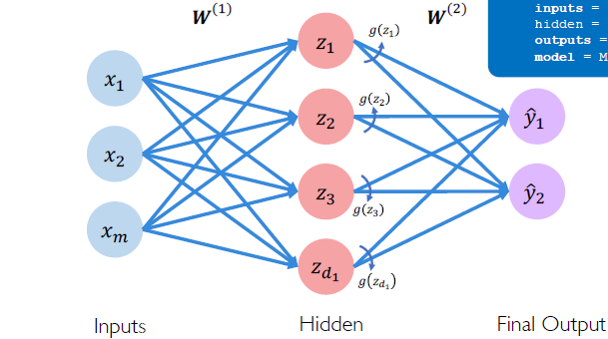

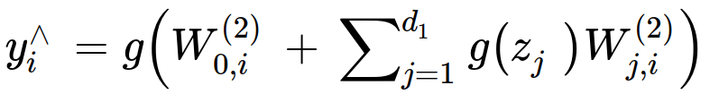
Single layer Neural network
© Alexander Amini and Ava Amini MIT Introduction to Deep Learning IntroToDeepLearning.com

Slide 5
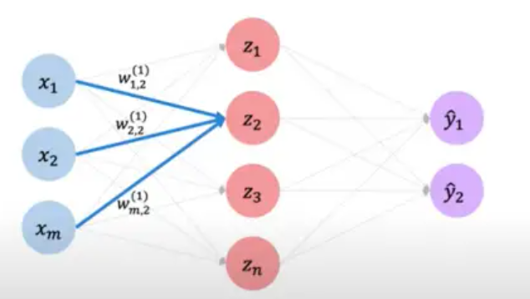
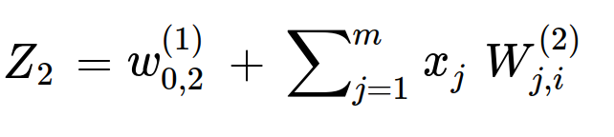
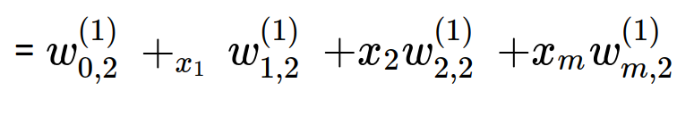
Single layer Neural Network
© Alexander Amini and Ava Amini MIT Introduction to Deep Learning IntroToDeepLearning.com

Slide 6
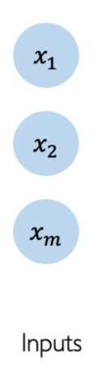



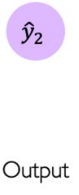

Deep Neural Network
Hidden

Slide 7
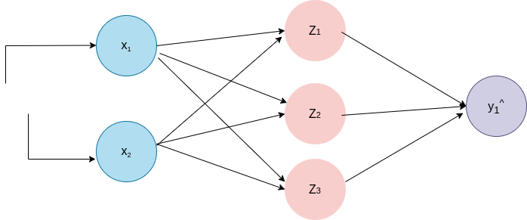

Example problem: Will I pass?
X ⁽¹⁾ = [4,5]
Predicted = 0.1 Actual =1
Predicted Actual

Slide 8
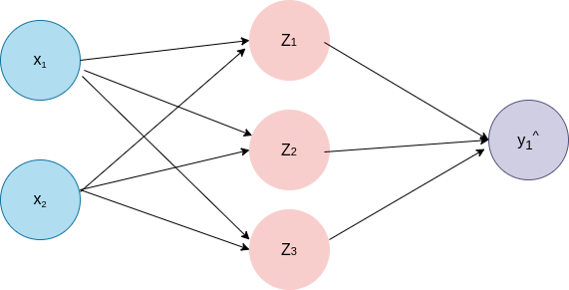
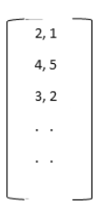



Empirical Loss
f(x) y
√
√
√
x

Slide 9


Different Cost Functions
Mean Square Error (MSE)
Mean Absolute Error (MAE)
Cross Entropy

Slide 10
Binary Cross Entropy loss
√
√
√
x

Slide 11


Mean Squared Error Loss
x
√
√
x

Slide 12




Loss Optimization
The goal is to find the weights (w) that minimize the loss
w* =

Slide 13
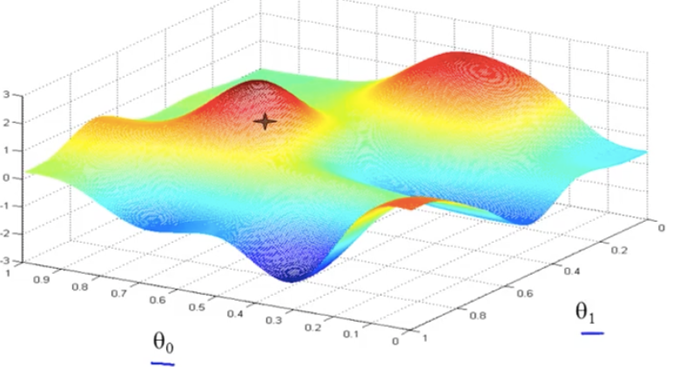



Loss Optimization
© Alexander Amini and Ava Amini MIT Introduction to Deep Learning IntroToDeepLearning.com

Slide 14
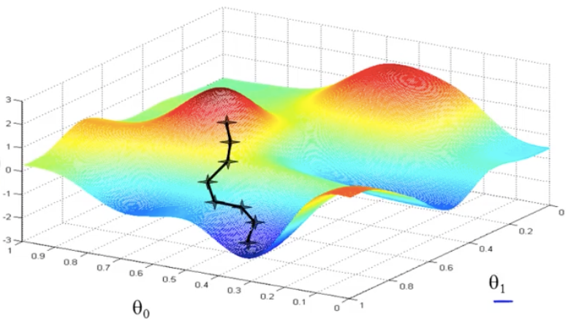
Gradient Descent
Repeat until convergence
© Alexander Amini and Ava Amini MIT Introduction to Deep Learning IntroToDeepLearning.com

Slide 15


Gradient Descent
Algorithm
Initialize weights randomly ~
Lop until convergence
Compute gradient,
Update weights w ⟵ w- α
Return weights

Slide 16





Gradient Descent : back Propagation
W1
W2
J(w)
?
y^
Using chain rule
W1
W2
y^
J(w)
W1
W2
y^
J(w)

Slide 17
Different Gradient Descent
Batch gradient descent: Computes the gradient of the loss function with respect to the parameters using the entire training dataset at once.
Stochastic gradient descent (SGD): Updates the parameters after each individual training example. This can lead to faster convergence, but the optimization may be more noisy.
Mini-batch gradient descent: In mini-batch gradient descent, the algorithm computes the gradient on a small batch of data at a time, rather than the entire dataset or a single example.
RMSprop:
Adam: Adam (adaptive moment estimation)

Slide 18

Stochastic Gradient Descent
Algorithm
Initialize weights randomly ~
Lop until convergence
Pick single data point i
Compute gradient,
Update weights w ⟵ w- α
Return weights

Slide 19

Mini-batch Gradient Descent
Algorithm
Initialize weights randomly
Shuffle the training data.
For each mini-batch (B):
Compute gradient
Update weights w ⟵ w- α

Slide 20
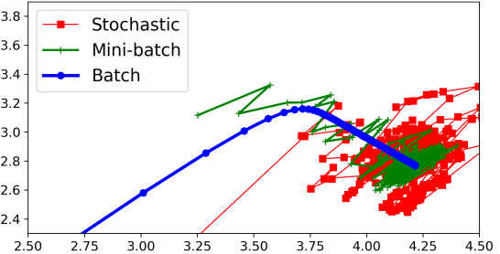
Gradient Descent Comparison
w1
w0
https://medium.com/analytics-vidhya/all-you-need-to-know-about-gradient-descent-f0178c19131d

